Slide 1
IS 120
Intro to JavaScript

Slide 2
“Quiet Hiring”
Companies are shifting away from posting jobs on career sites, and instead having recruiters do cold outreach in fields where the number of applicants far surpasses the open jobs.
To succeed, job seekers have to market themselves by posting about their projects and thoughts on LinkedIn.

Slide 3
“Quiet Hiring”
https://heatheralicia.com
https://joshuasolano.com
https://tannerbriggsresume.netlify.app/
https://www.eddyog.com/
https://www.calebbradshaw.dev
https://bradenstevens.com/

Slide 4
“Quiet Hiring”
Create a website
Create a LinkedIn
Post 2-3 times a semester about what you’re working on

Slide 5
Final Project
Project 3 will be your last “programming” project
Your Final Project might involve...
  Updating and posting on LinkedIn
  Updating your resume
  Plan for applying to jobs and projects
  Identifying new things you want to learn over the summer

Slide 6
Pair Programming Follow Up
Apple Nav Expand on Hover
Figma Auto Scroll Carousel
Rotating Title

Slide 7
Reverse Engineering
Use AI to figure out the pieces of the problem you don’t understand, not to give you a complete solution
Think of it as researching what tools are available
As a programmer, your most important skill is not remembering specific syntax, it’s understanding how to solve a problem

Slide 8
Reverse Engineering
Figma Example:
  This needs to rotate infinitely, so let’s just transform it to the left and put it on an infinite loop. Now let’s try to make that look seamless instead of jumping around.
  I know we need to stop this animation at a certain state, probably on :hover. How do we stop an animation?

Slide 9
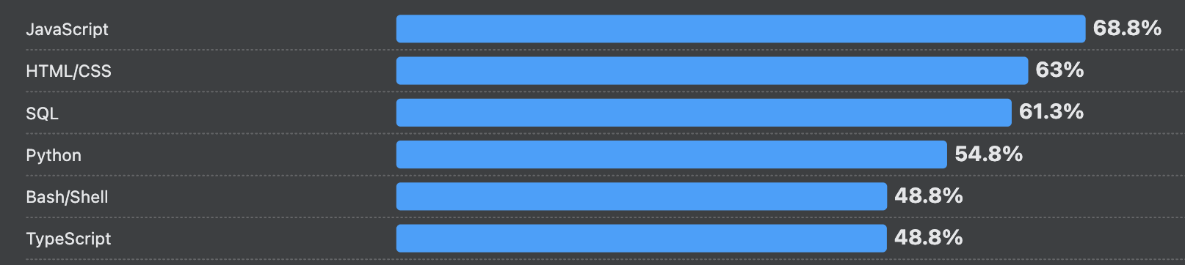
What is JavaScript?
The main language of the web
Makes websites interactive
The most widely used programming language

Slide 10



What is JavaScript?
Originally meant for browsers and web pages, but is widely used for other various platforms
Backend Servers
Desktop Apps
Mobile Apps
Games

Slide 11
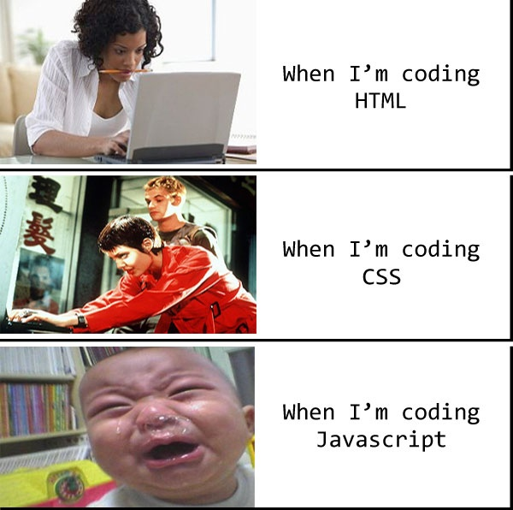
What is JavaScript?
Programmers have a love hate relationship with JavaScript
Has a lot of quirks and inconsistencies
Single threaded -> Can only do one thing at a time (unlike most other languages)

Slide 12
What is JavaScript?
This is why TypeScript exists!

Slide 13
Where Does JavaScript Go?
Similar to CSS
  Inline, Internal, External
JavaScript needs to load after our HTML and CSS
  Visuals should load before logic
Demo

Slide 14
JavaScript Variables
var -> old, don’t use
let -> can be reassigned
const -> cannot be reassigned

Slide 15
JavaScript Variables
Type of the variable is assumed
string -> “hello”
Number -> 42.5
Boolean -> true
Demo

Slide 16
JavaScript Variables
null -> intentionally empty value
undefined -> never assigned a value
NaN -> happens when math goes wrong (“hello” / 2)

Slide 17
JavaScript Arithmetic
Basic math operators -> +, -, *, /
+ also works for putting strings together
This makes for some really weird JavaScript bugs
Demo

Slide 18
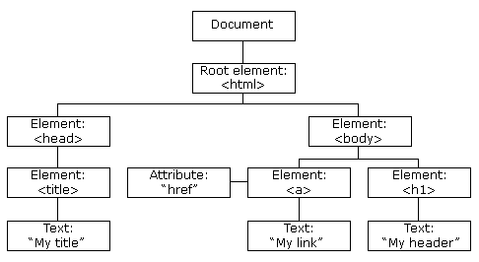
The DOM
Document Object Model (DOM)
The browser’s representation of your HTML page

Slide 19
The DOM
HTML -> the file you wrote
DOM -> what the browser built
JS -> how you interact with the DOM
Interacting with the DOM through the browser console

Slide 20
JavaScript DOM Selectors
Always prefaced with -> document
querySelector() -> use CSS selector to get the FIRST element
getElementByID() -> older, more limited, don’t use

Slide 21
JavaScript DOM Properties
textContent -> give an element text
innerHTML -> inject HTML inside an element
style -> add css attributes
setAttribute -> change something like src or alt
classList -> modify classes tied to element
Demo

Slide 22
JavaScript DOM Manipulation
Pair program
Start with an empty button -> <button></button>
Add basic text, styles, attributes, and classes using JS
Don’t worry about hover effects
Try using all properties -> textContent, innerHTML, style, setAttribute, classList

Slide 23
JavaScript DOM Element Creation
You can create new HTML elements using the DOM
createElement(“div”) -> creates a new element
appendChild() -> choose where the new element goes
remove() -> deletes element
Demo with button

